Slide 1
PRODUCT SALES ANALYSIS USING DATA ANALYTICS
Presented By:
K NITHISH
912421104025

Slide 2

INDRODUCTION
OBJECTIVE
ABSTRACT
DATA ANALYSIS
MARKET SEGMENTATION
DIAGONASTIC ANALYSIS
DATA COLLECTION
SALES MANAGEMENT
CONCLUSION

Slide 3

INDRODUCTION
Product introduction is the marketing tactic used to increase sales by advertising a product before it's released. A company's sales or marketing division is usually in charge of this process that begins when a product has finished testing or been authorized for sales. The marketing team uses techniques to create a consumer response, including excitement about new ideas or solutions

Slide 4

OBJECTIVE
The sales objectives you set need to make sense for your business or department. You might be setting sales objectives that focus on Increasing annual sales and profit Increasing customer numbers Increasing up sells and cross-sells Improving customer retention Increasing conversion rates Increasing sales rep productivity

Slide 5

ABSTRACT
It is of particular importance in the highly saturated food markets of developed countries, where consumer needs are shifting closer and closer towards the search for quality and emotional benefits.
This study sets out to explore variation in the consumer choice structure in relation to three products with different levels of search, experience and credence attributes, using means-end chain theory.

Slide 6

DATA ANALYSIS
This type of sales analysis is perfect for large companies and/or companies with extensive product offerings. Why? Because it helps them determine which products actually affect their bottom lines. Use it to better understand your company's demographics, pinpoint popular products, and the like.

Slide 7

MARKET SEGMENTATION
Market segmentation data analysis is a method of breaking your customers or potential market down into actionable categories- into groups that you can treat differently from one another in an effort to reach them more effectively.
Market segmentation is a process companies use to break their potential customers into different sections.

Slide 8

DIAGONASTIC ANALYTICS
Analytics is the systematic computational analysis of data or statistics.[1] It is used for the discovery, interpretation, and communication of meaningful patterns in data. It also entails applying data patterns toward effective decision-making. It can be valuable in areas rich with recorded information; analytics relies on the simultaneous application of statistics, computer programming, and operations research to quantify performance

Slide 9

DATA COLLECTION
Data collection or data gathering is the process of gathering and measuring information on targeted variables in an established system, which then enables one to answer relevant questions and evaluate outcomes. Data collection is a research component in all study fields, including physical and social sciences, humanities,[2] and business.

Slide 10
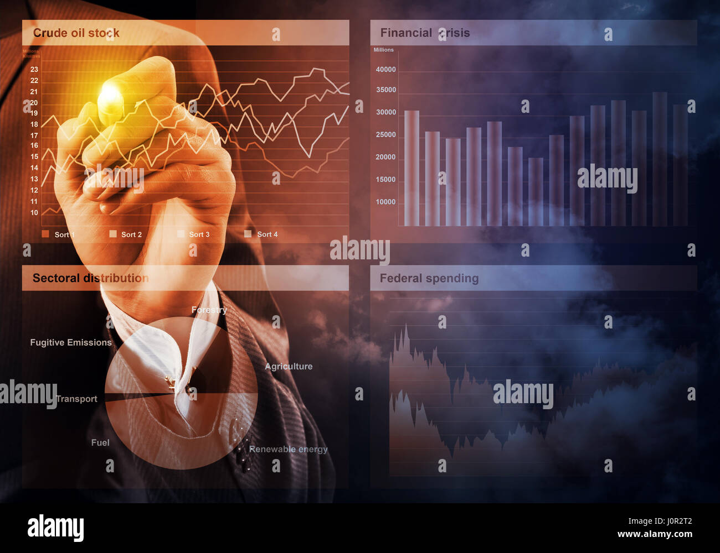
SALES MANAGEMENT
Sales management is a business discipline which is focused on the practical application of sales techniques and the management of a firm's sales operations. It is an important business function as net sales, through the sale of products and services and resulting profit, drive most commercial business. These are also typically the goals and performance indicators of sales management Sales manager is the typical title of someone whose role is sales management. The role typically involves talent development.

Slide 11
CONCLUSION
Product data analytics is an essential aspect of the product management process. It enables teams to analyze user behavior and product performance and make informed decisions to improve the product and customer experience.

